Slide 1

Chapter 7
Advanced Encryption Standard
(AES)
Copyright © The McGraw-Hill Companies, Inc. Permission required for reproduction or display.

Slide 2
Chapter 7
Objectives
❏ To review a short history of AES
❏ To define the basic structure of AES
❏ To define the transformations used by AES
❏ To define the key expansion process
❏ To discuss different implementations

Slide 3
7-1 INTRODUCTION
The Advanced Encryption Standard (AES) is a symmetric-key block cipher published by the National Institute of Standards and Technology (NIST) in December 2001.

Slide 4
7.1.1 History.
In February 2001, NIST announced that a draft of the Federal Information Processing Standard (FIPS) was available for public review and comment. Finally, AES was published as FIPS 197 in the Federal Register in December 2001.

Slide 5
7.1.2 Criteria
The criteria defined by NIST for selecting AES fall into three areas:
1. Security : 128 bit key, resistance to cryptanalysis attacks
2. Cost: computational efficiency & storage requirements
3. Implementation : flexibility & simplicity

Slide 6

7.1.3 Rounds.
AES is a non-Feistel cipher that encrypts and decrypts a data block of 128 bits. It uses 10, 12, or 14 rounds. The key size, which can be 128, 192, or 256 bits, depends on the number of rounds.
Note
AES has defined three versions, with 10, 12, and 14 rounds.
Each version uses a different cipher key size (128, 192, or 256), but the round keys are always 128 bits.

Slide 7
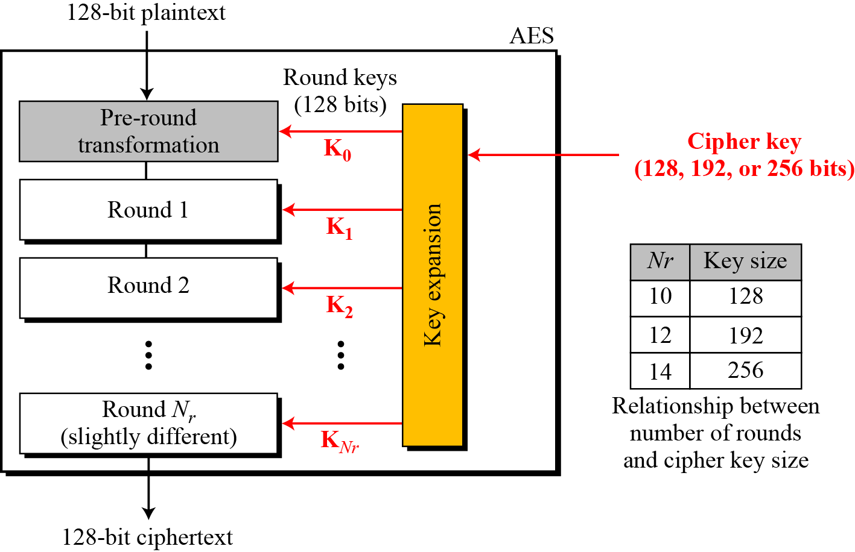
7.1.3 Continue
Figure 7.1 General design of AES encryption cipher

Slide 8
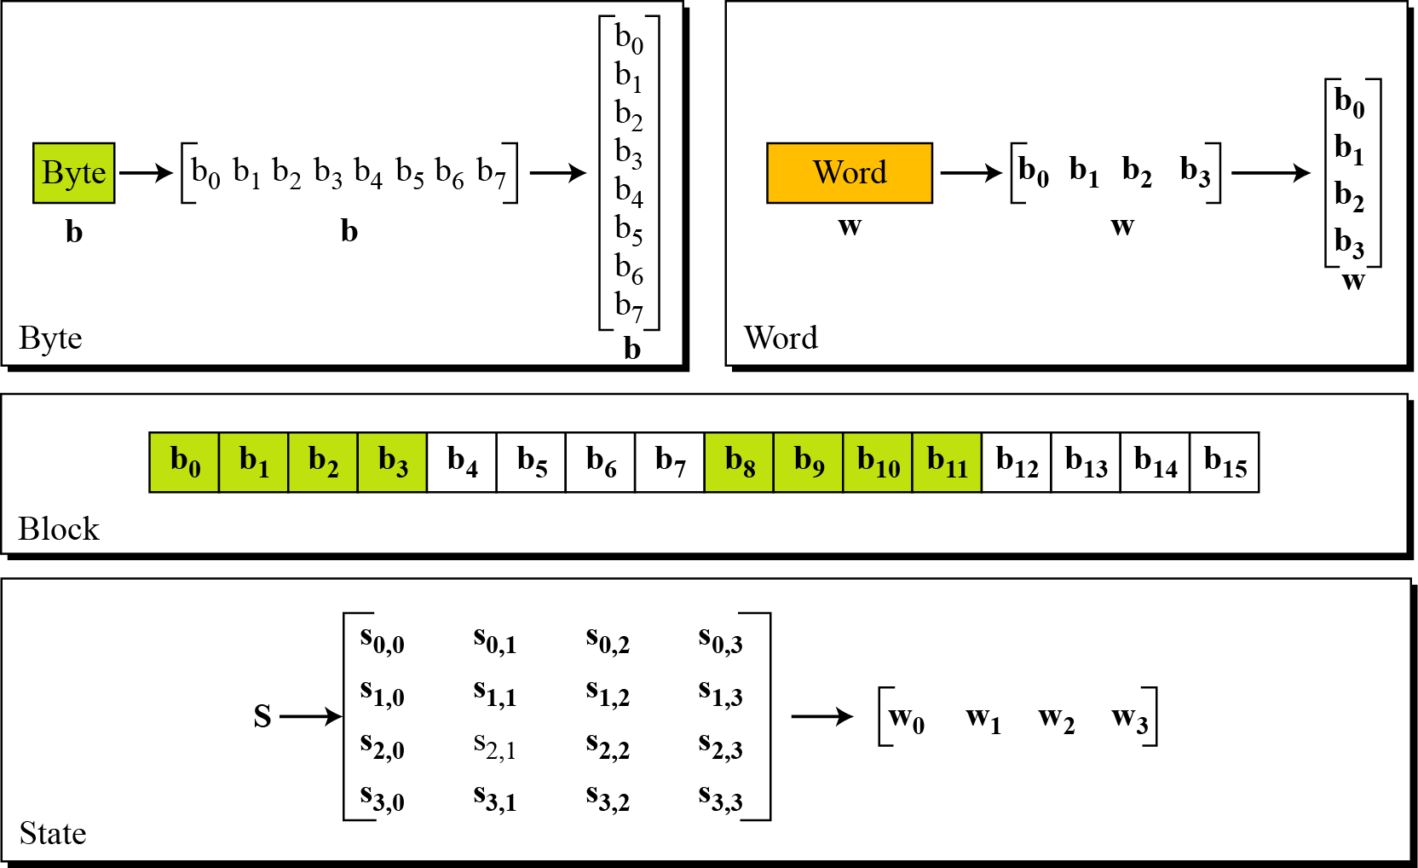
7.1.4 Data Units.
Figure 7.2 Data units used in AES

Slide 9
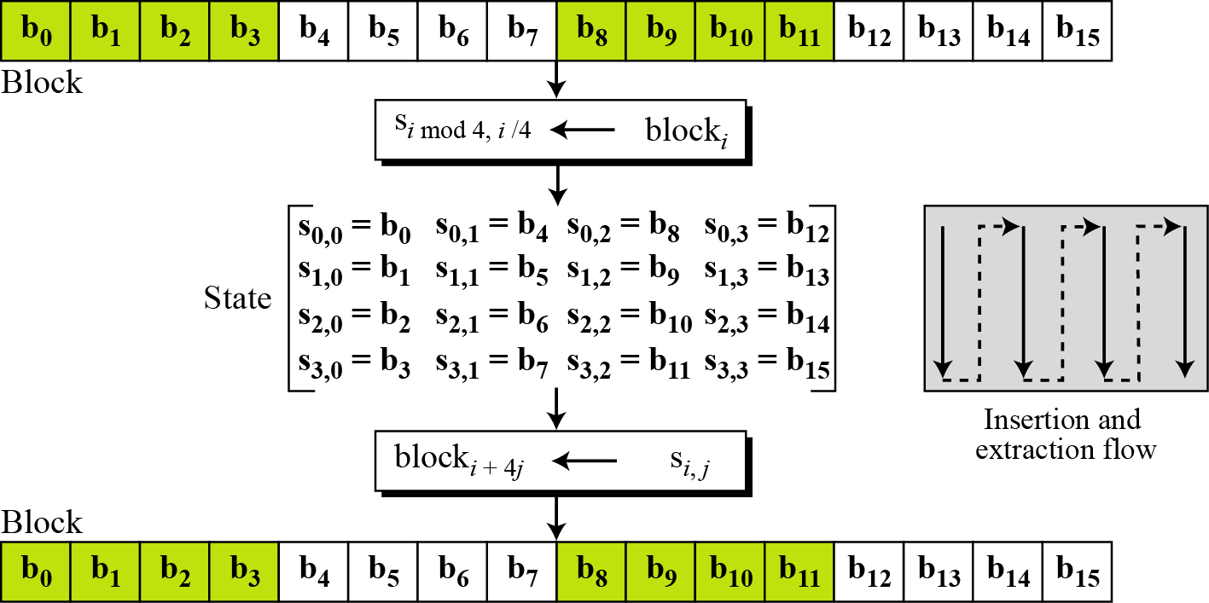
7.1.4 Continue
Figure 7.3 Block-to-state and state-to-block transformation

Slide 10
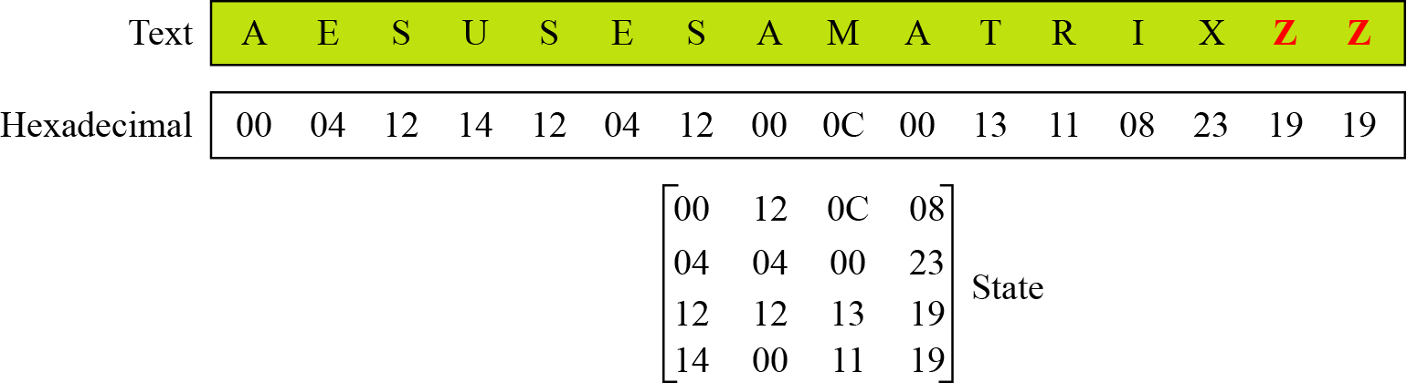
7.1.4 Continue
Example 7.1
Continue
Figure 7.4 Changing plaintext to state

Slide 11
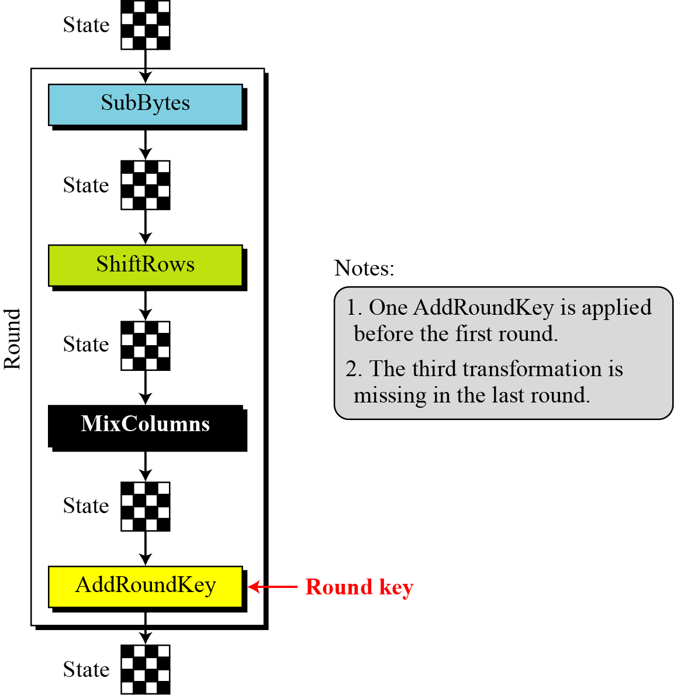
7.1.5 Structure of Each Round
Figure 7.5 Structure of each round at the encryption site

Slide 12
7-2 TRANSFORMATIONS
To provide security, AES uses four types of transformations:
substitution,
permutation,
mixing, and
key-adding.

Slide 13
7.2.1 Substitution
AES, like DES, uses substitution. AES uses two invertible transformations.
SubBytes
The first transformation, SubBytes, is used at the encryption site. To substitute a byte, we interpret the byte as two hexadecimal digits.
Note
The SubBytes operation involves 16 independent byte-to-byte transformations.

Slide 14
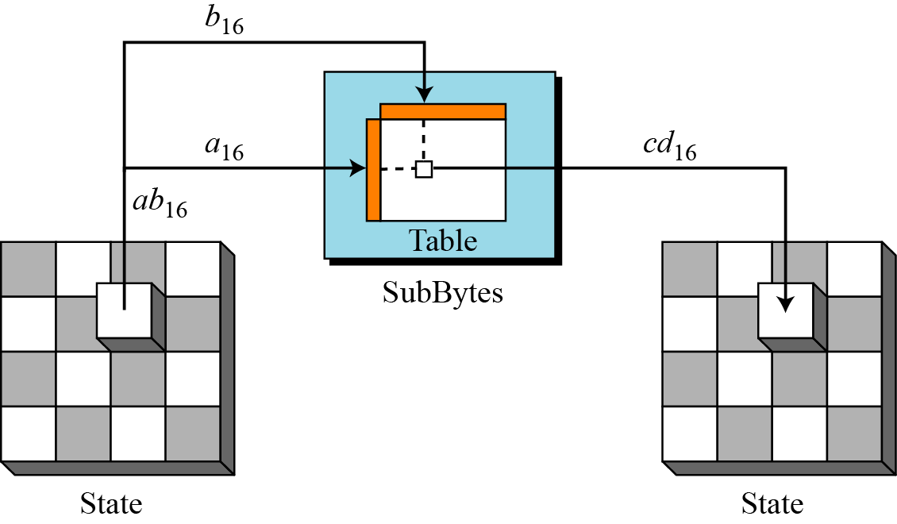
7.2.1 Continue
Figure 7.6 SubBytes transformation

Slide 15
7.2.1 Continue

Slide 16
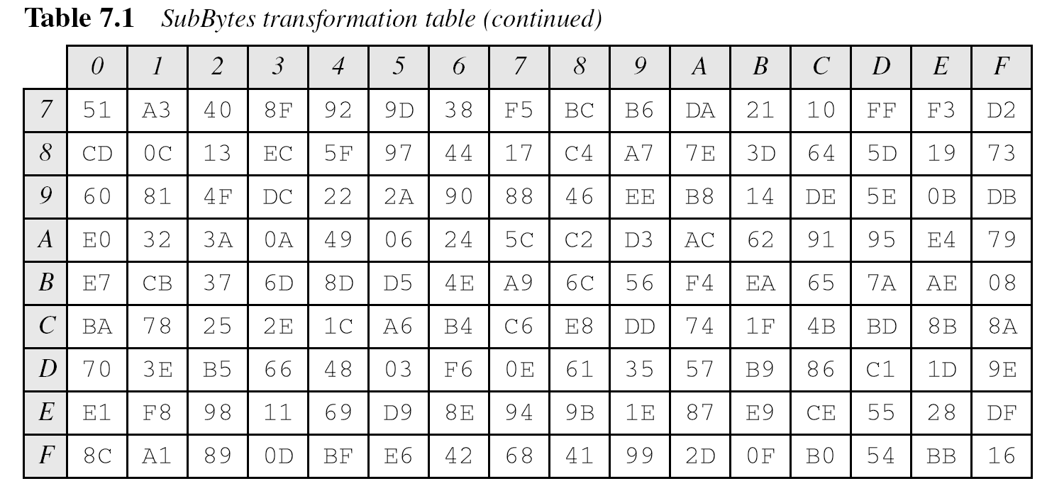
7.2.1 Continue

Slide 17
7.2.1 Continue
InvSubBytes

Slide 18
7.2.1 Continue
InvSubBytes (Continued)

Slide 19
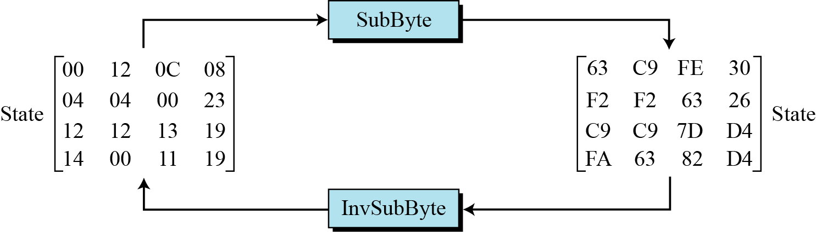
7.2.1 Continue
Example 7.2
Figure 7.7 shows how a state is transformed using the SubBytes transformation. The figure also shows that the InvSubBytes transformation creates the original one. Note that if the two bytes have the same values, their transformation is also the same.
Figure 7.7 SubBytes transformation for Example 7.2

Slide 20
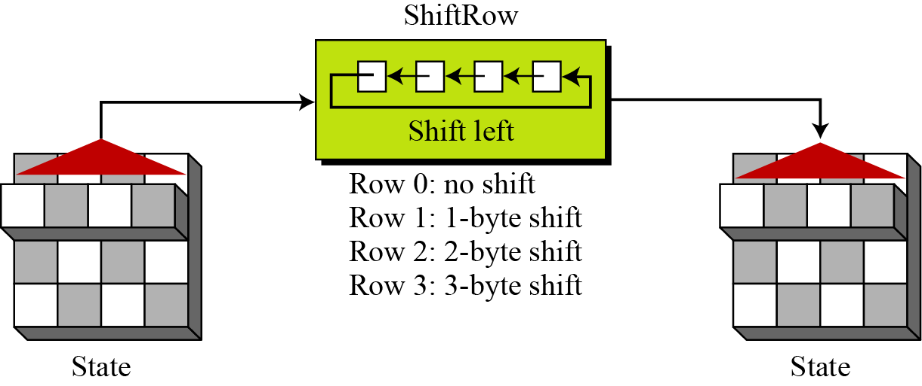
7.2.2 Permutation
Another transformation found in a round is shifting, which permutes the bytes.
ShiftRows
In the encryption, the transformation is called ShiftRows.
Figure 7.9 ShiftRows transformation

Slide 21
7.2.2 Continue
InvShiftRows
In the decryption, the transformation is called InvShiftRows and the shifting is to the right.

Slide 22
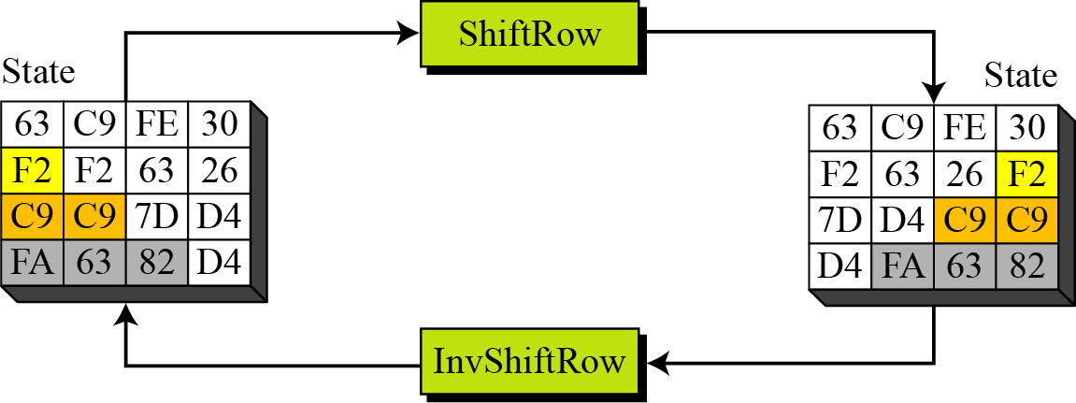
7.2.2 Continue
Example 7.4
Figure 7.10 shows how a state is transformed using ShiftRows transformation. The figure also shows that InvShiftRows transformation creates the original state.
Figure 7.10 ShiftRows transformation in Example 7.4

Slide 23
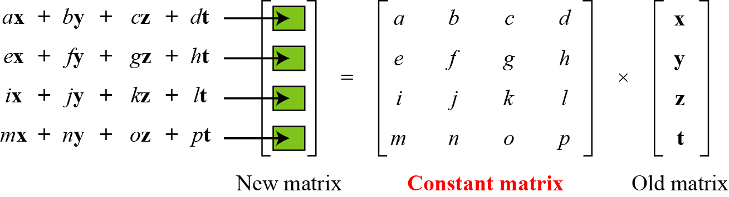
7.2.3 Mixing
We need an interbyte transformation that changes the bits inside a byte, based on the bits inside the neighboring bytes. We need to mix bytes to provide diffusion at the bit level.
Figure 7.11 Mixing bytes using matrix multiplication

Slide 24
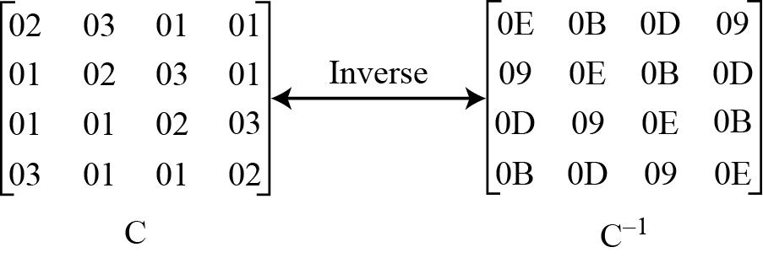
7.2.3 Continue
Figure 7.12 Constant matrices used by MixColumns and InvMixColumns

Slide 25
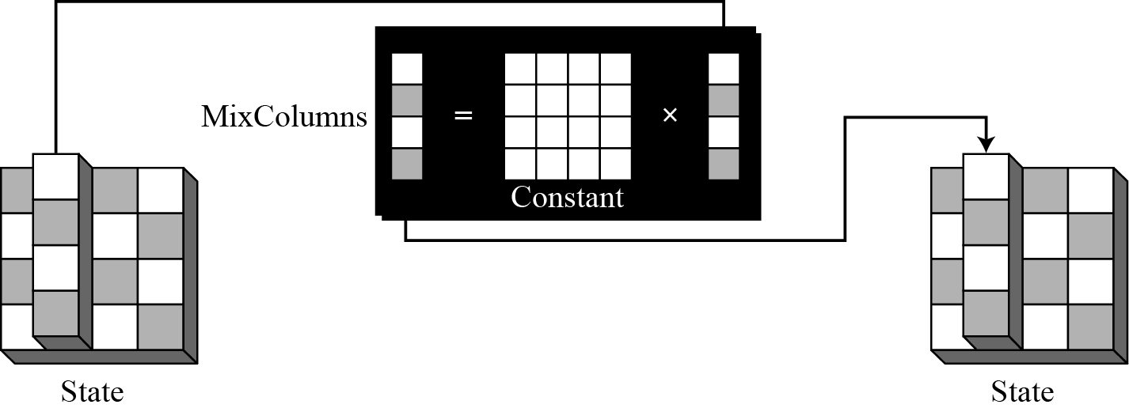
7.2.3 Continue
MixColumns
The MixColumns transformation operates at the column level; it transforms each column of the state to a new column.
Figure 7.13 MixColumns transformation

Slide 26
7.2.3 Continue
InvMixColumns
The InvMixColumns transformation is basically the same as the MixColumns transformation.
Note
The MixColumns and InvMixColumns transformations are inverses of each other.

Slide 27
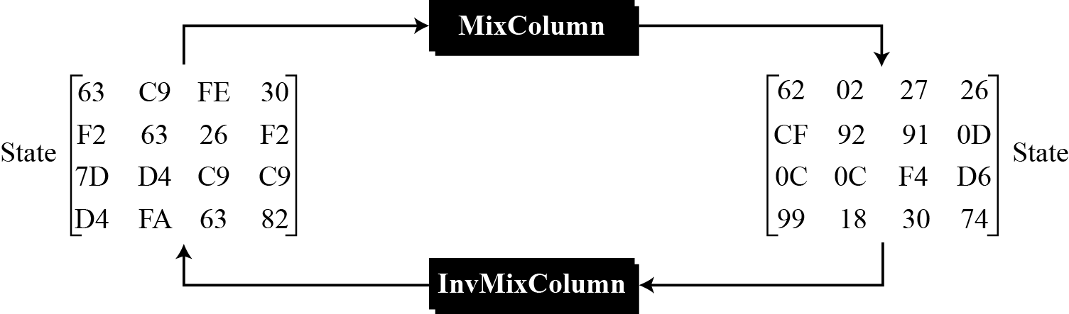
7.2.3 Continue
Example 7.5
Figure 7.14 shows how a state is transformed using the MixColumns transformation. The figure also shows that the InvMixColumns transformation creates the original one.
Figure 7.14 The MixColumns transformation in Example 7.5

Slide 28
7.2.4 Key Adding
AddRoundKey
AddRoundKey proceeds one column at a time. AddRoundKey adds a round key word with each state column matrix; the operation in AddRoundKey is matrix addition.
Note
The AddRoundKey transformation is the inverse of itself.

Slide 29
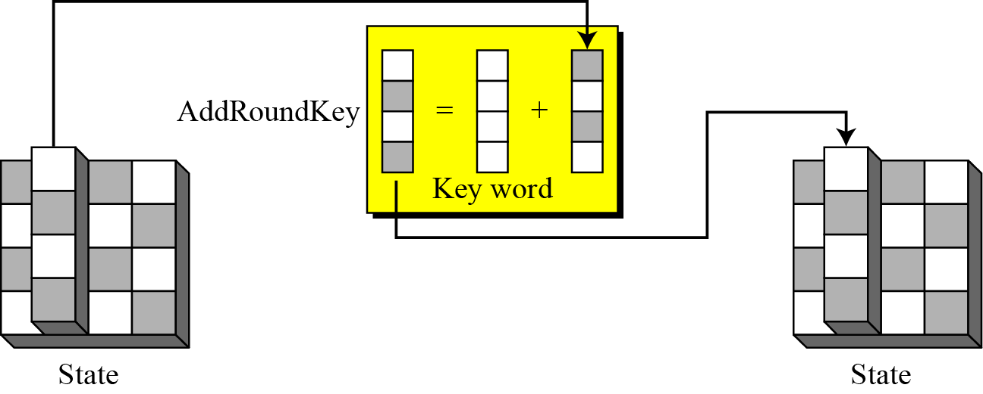
7.2.4 Continue
Figure 7.15 AddRoundKey transformation

Slide 30
7-3 KEY EXPANSION
To create round keys for each round, AES uses a key-expansion process. If the number of rounds is N_{r} , the key-expansion routine creates N_{r} + 1 128-bit round keys from one single 128-bit cipher key.

Slide 31
7-3 Continued

Slide 32
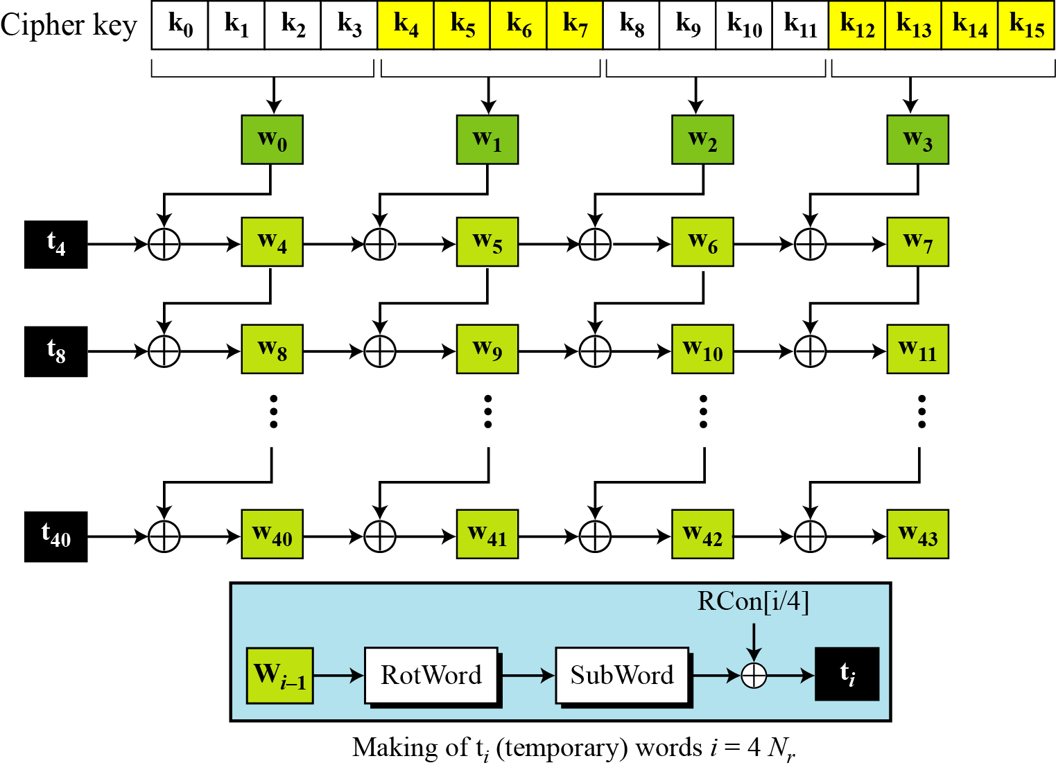
7.3.1 Key Expansion in AES-128
Figure 7.16 Key expansion in AES

Slide 33
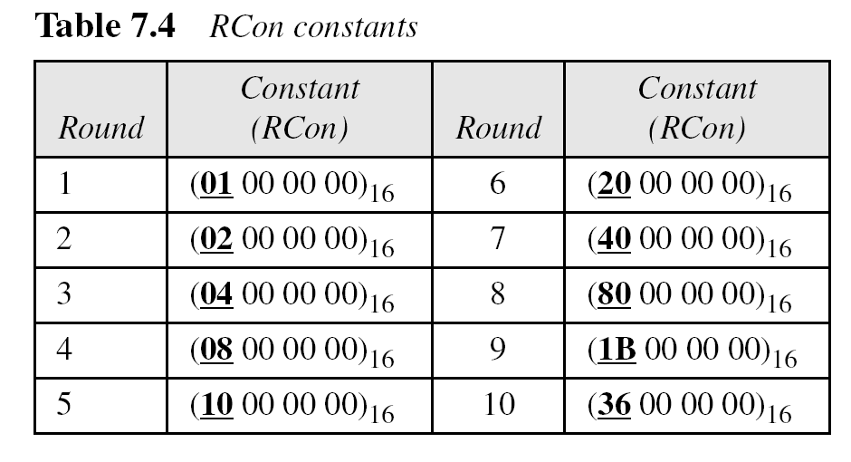
7.3.1 Continue

Slide 34
7.3.1 Continue
Example 7.6
Table 7.5 shows how the keys for each round are calculated assuming that the 128-bit cipher key agreed upon by Alice and Bob is (24 75 A2 B3 34 75 56 88 31 E2 12 00 13 AA 54 87)₁₆.

Slide 35
7.3.1 Continue
Example 7.7
Each round key in AES depends on the previous round key. The dependency, however, is nonlinear because of SubWord transformation. The addition of the round constants also guarantees that each round key will be different from the previous one.
Example 7.8
The two sets of round keys can be created from two cipher keys that are different only in one bit.

Slide 36
7.3.1 Continue
Example 7.8
Continue

Slide 37
7.3.2 Key Expansion in AES-192 and AES-256
Key-expansion algorithms in the AES-192 and AES-256 versions are very similar to the key expansion algorithm in AES-128, with the following differences:
In AES-192, words are generated ingroups of 6 instead of four
In AES-256, words are generated ingroups of 8 instead of four

Slide 38
7-4 CIPHERS
AES uses four types of transformations for encryption and decryption. In the standard, the encryption algorithm is referred to as the cipher and the decryption algorithm as the inverse cipher.
Topics discussed in this section:
7.4.1 Original Design
7.4.2 Alternative Design

Slide 39
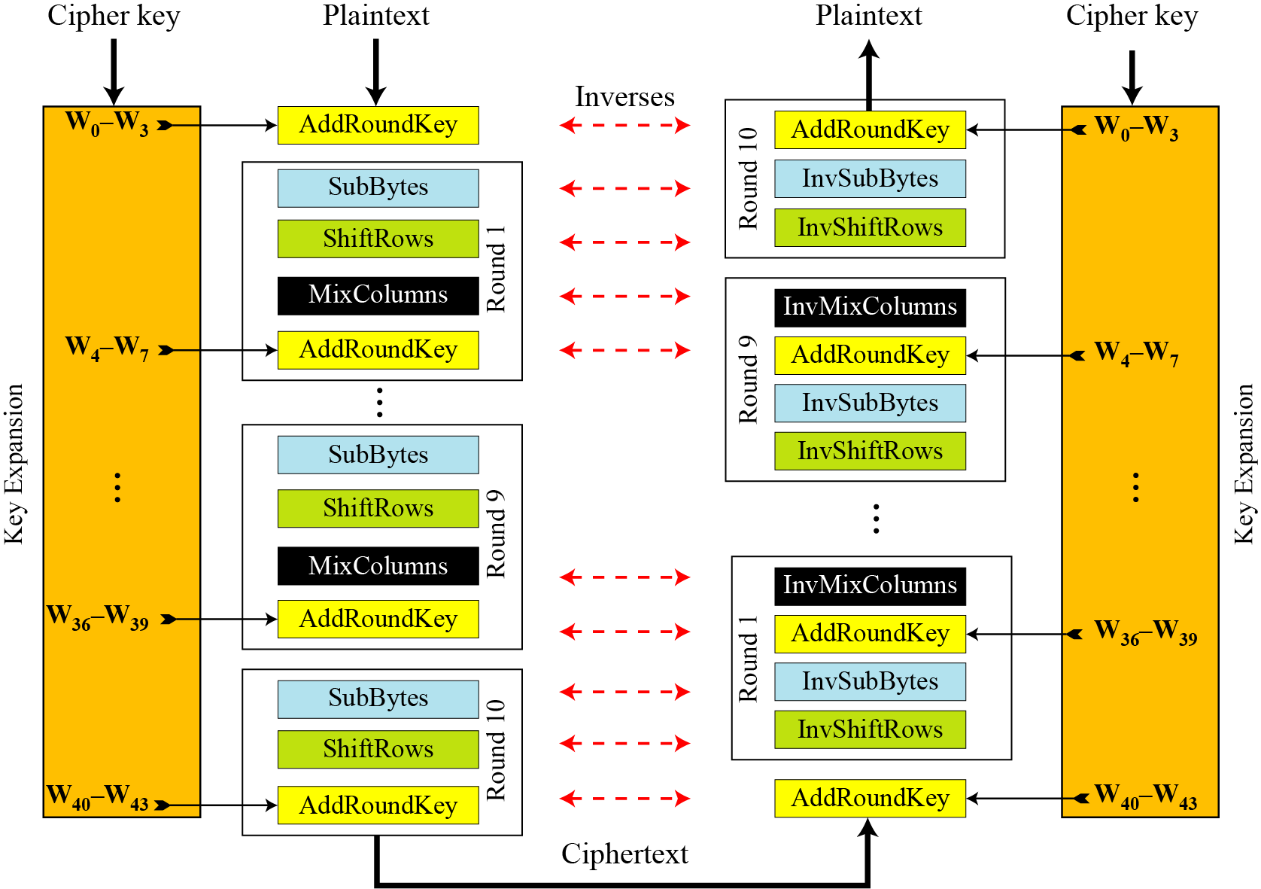
7.4.1 Original Design
Figure 7.17 Ciphers and inverse ciphers of the original design

Slide 40
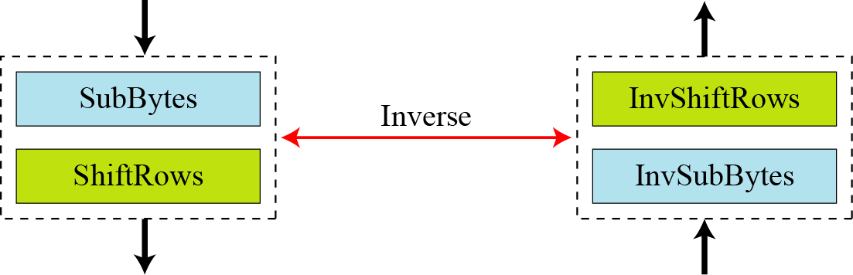
7.4.2 Alternative Design
Figure 7.18 Invertibility of SubBytes and ShiftRows combinations

Slide 41
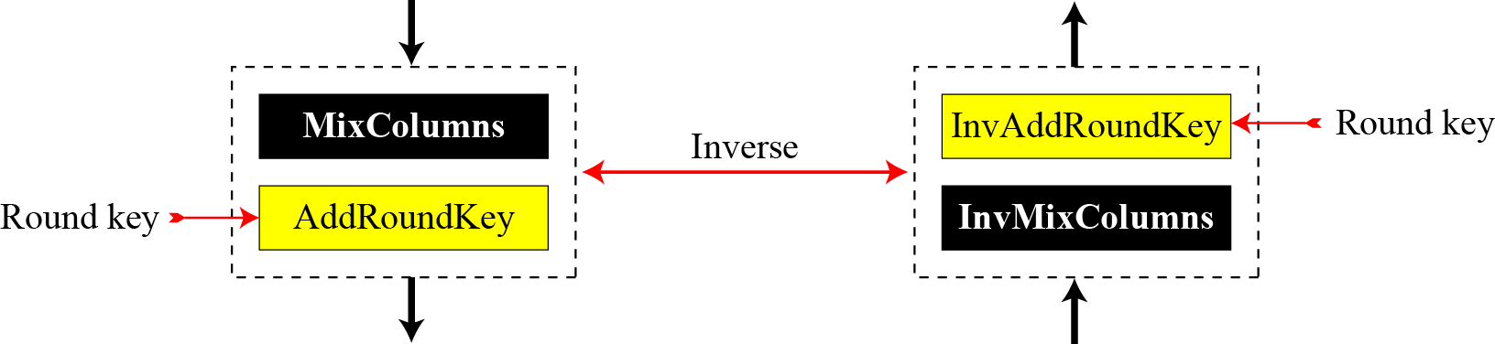
7.4.2 Continue
Figure 7.19 Invertibility of MixColumns and AddRoundKey combination

Slide 42
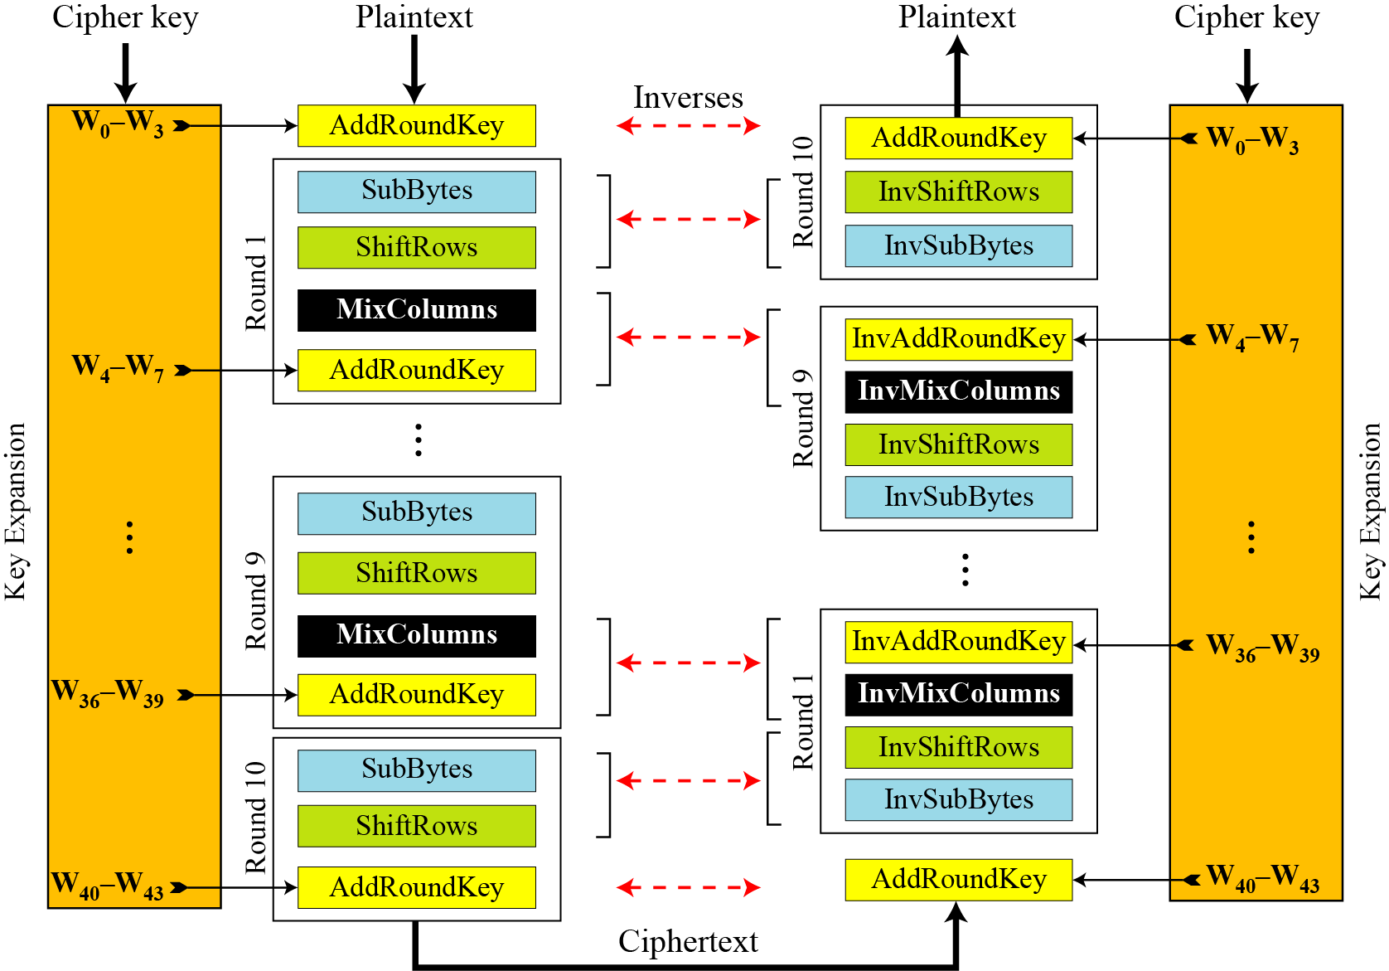
7.4.2 Continue
Figure 7.20 Cipher and reverse cipher in alternate design

Slide 43
7.4.2 Continue
Changing Key-Expansion Algorithm
Instead of using InvRoundKey transformation in the reverse cipher, the key-expansion algorithm can be changed to create a different set of round keys for the inverse cipher.

Slide 44
7-5 Examples
In this section, some examples of encryption/ decryption and key generation are given to emphasize some points discussed in the two previous sections.
Example 7.10
The following shows the ciphertext block created from a plaintext block using a randomly selected cipher key.

Slide 45
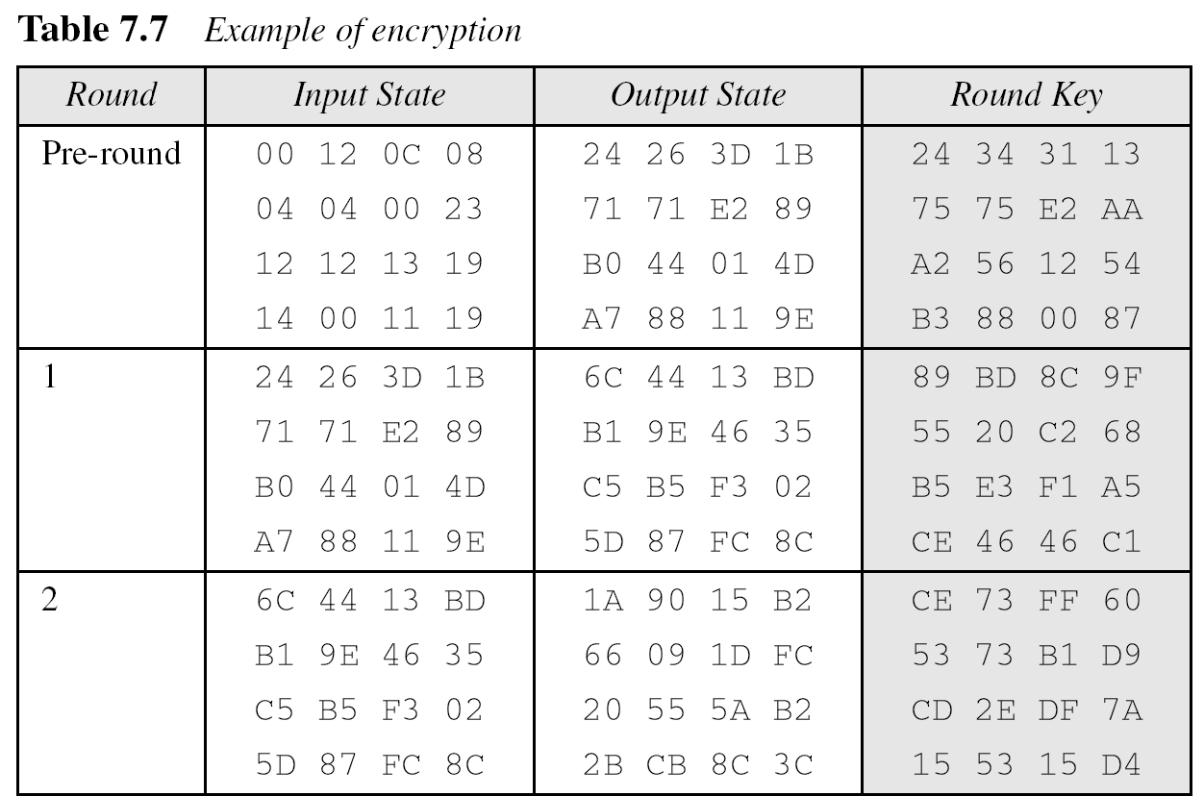
7-5 Continued
Example 7.10
Continued

Slide 46
7-5 Continued
Example 7.10
Continued

Slide 47
7-5 Continued
Example 7.10
Continued

Slide 48
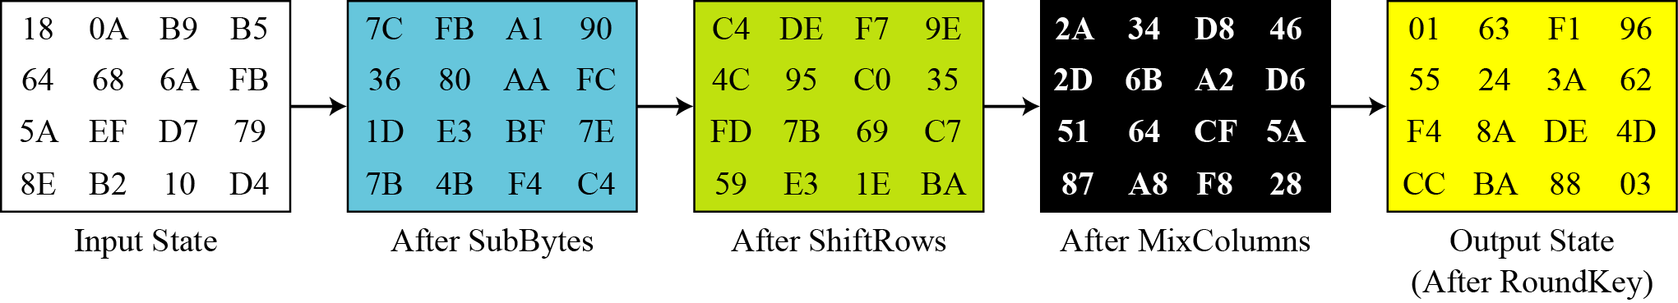
7-5 Continued
Example 7.11
Figure 7.21 shows the state entries in one round, round 7, in Example 7.10.
Figure 7.21 States in a single round

Slide 49
7-5 Continued
Example 7.12
One may be curious to see the result of encryption when the plaintext is made of all 0s. Using the cipher key in Example 7.10 yields the ciphertext.

Slide 50
7-5 Continued
Example 7.13
Let us check the avalanche effect that we discussed in Chapter 6. Let us change only one bit in the plaintext and compare the results. We changed only one bit in the last byte. The result clearly shows the effect of diffusion and confusion. Changing a single bit in the plaintext has affected many bits in the ciphertext.

Slide 51
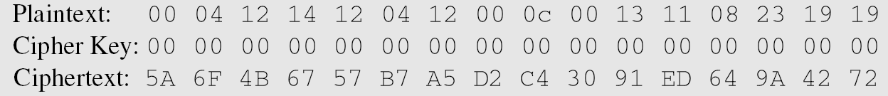
7-5 Continued
Example 7.14
The following shows the effect of using a cipher key in which all bits are 0s.

Slide 52
7.6.2 Implementation
AES can be implemented in software, hardware, and firmware. The implementation can use table lookup process or routines that use a well-defined algebraic structure.

Slide 53
7.6.3 Simplicity and Cost
The algorithms used in AES are so simple that they can be easily implemented using cheap processors and a minimum amount of memory.

